Slide 1

Green Pace
Security Policy Presentation
Developer: Jonathan Walton

Slide 2

OVERVIEW: DEFENSE IN DEPTH

Slide 3
THREATS MATRIX
Likely STD-003-CPP, STD-004-CPP, STD-005-CPP, STD-007-CPP, STD-008-CPP, STD-010-CPP | High Priority STD-003-CPP, STD-004-CPP, STD-005-CPP, STD-006-CPP, STD-008-CPP, STD-010-CPP
Low Priority STD-001-CPP, STD-002-CPP, STD-007-CPP, STD-009-CPP | Unlikely STD-001-CPP, STD-002-CPP, STD-006-CPP, STD-009-CPP

Slide 4
10 PRINCIPLES
Validate Input Data STD-001-CPP | Adhere to the Principle of Least Privilege STD-005-CPP, STD-007-CPP
Heed Compiler Warnings STD-001-CPP, STD-002-CPP, STD-003-CPP, STD-005-CPP, STD-006-CPP | Sanitize Data Sent to Other Systems STD-004-CPP
Architect and Design for Security Policies STD-001-CPP – STD-010-CPP | Practice Defense in Depth STD-004-CPP, STD-005-CPP, STD-007-CPP
Keep it Simple STD-001-CPP, STD-002-CPP, STD-005-CPP, STD-006-CPP, STD-010-CPP | Use Effective Quality Assurance Techniques STD-008-CPP, STD-009-CPP
Default Deny STD-CPP-009 | Adopt a Secure Coding Standard STD-001-CPP – STD-010-CPP

Slide 5
CODING STANDARDS
STD-001-CPP Include the appropriate type information in function declarators | STD-006-CPP Understand the termination behavior of assert() and abort()
STD-002-CPP Do not begin integer constants with 0 when specifying a decimal value | STD-007-CPP Handle all exceptions
STD-003-CPP Use valid references, pointers, and iterators to reference elements of a basic string | STD-008-CPP Detect and handle memory allocation errors
STD-004-CPP Prevent SQL injection | STD-009-CPP Use a static assertion to test the value of a constant expression
STD-005-CPP Do not access freed memory | STD-010-CPP Do not depend on the order of evaluation for side effects

Slide 6
ENCRYPTION POLICIES
Encryption In-Rest Data that is physically stored and not actively being moved from one device or network to another is covered by this policy. Examples of this type of data include that on personal computers, portable storage devices (like flash drives), and external hard drives. | Encryption At-Flight Data that is actively being moved from one device or network to another is covered by this policy. This includes both local networks and public networks. | Encryption In-Use Data that is currently being updated, processed, erased, accessed, or read by a system is covered by this policy. An example of data in use is that of a database, which is highly prone to attacks and breaches.

Slide 7
TRIPLE-A POLICIES
Authentication Authenticating data is critical to ensure that data loss is prevented. User logins must be validated to affirm the identity of the individual. Examples of authentication include passwords, physical USB keys, and biometric identity verification. | Authorization Authorization grants levels of access to the user. The information about the user’s level of access are stored alongside their identity to ensure that they are granted the correct level of access. This policy dictates what the user is allowed to do and what they are allowed access to, such as files. | Accounting Accounting ensures that all activity is tracked during a user’s session. Additionally, information about their session length, what data was interfaced with, and other key elements are recorded. This policy is critical in tracking which files are accessed by users, as well as what changes were made to database entries.

Slide 8
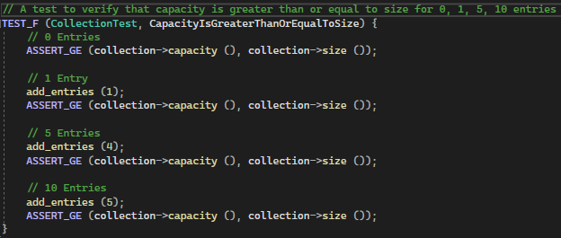

Unit Testing: CapacityIsGreaterThanOrEqualToSize

Slide 9
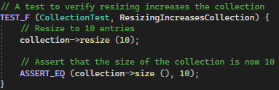

Unit Testing: ResizingIncreasesCollection

Slide 10
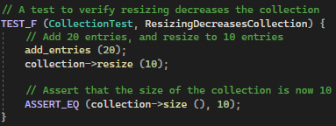

Unit Testing: ResizingDecreasesCollection

Slide 11
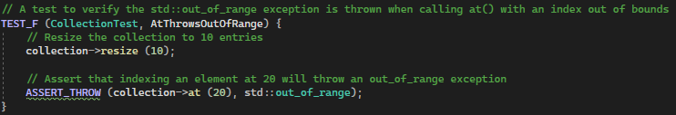

Unit Testing: AtThrowsOutOfRange

Slide 12

AUTOMATION SUMMARY

Slide 13
TOOLS
The DevSecOps pipeline is an integral portion of the security policy at Green Pace. This pipeline helps to formalize the process through which security practices and tooling can be implemented as part of a security-first paradigm.
A major component of the DevSecOps pipeline is a direct focus upon the implementation of automation as a security practice.
Automation is integrated as a part of the SDLC through scanning, threat intelligence, static analysis, and compliance validation. Tools like SAST and DAST help in ensuring a process that focuses on continuous security.

Slide 14
RISKS AND BENEFITS
Act Now Prevent attacks based on industry standard information Defense in Depth strategies can ameliorate possible failures Saves time and money in the long run | Wait and See Failure to prevent attacks can have major negative implications Reworking codebases to introduce new security features can be costly Revenue and reputation can be damaged

Slide 15
RECOMMENDATIONS
Current gaps in Green Pace’s Security Policy:
Limited standard coverage
Lack of cross-language and multi-language policy
Inconcrete tooling standardization
No zero-trust policy in place

Slide 16
CONCLUSIONS
Recommended steps and standards:
Adopt a wider range of standards from the SEI CERT C++ Standard
Adopt SEI CERT multi-language standards
Select and enforce the use of automation tooling
Enforce zero-trust security policies for all future developments

Slide 17
REFERENCES
Check Point. (n.d.). What is a DevSecOps pipeline? https://www.checkpoint.com/cyber-hub/cloud-
security/devsecops/what-is-a-devsecops-pipeline/
Software Engineering Institute. (2020, May 29). SEI CERT C++ coding standard. Carnegie Mellon University. https://wiki.sei.cmu.edu/confluence/pages/viewpage.action?pageId= 88046682

